Slide 1
How can you explain the effect of
polluted water or global warming issue?

Slide 2
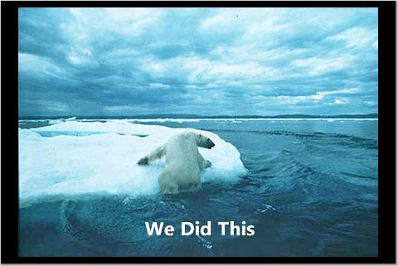
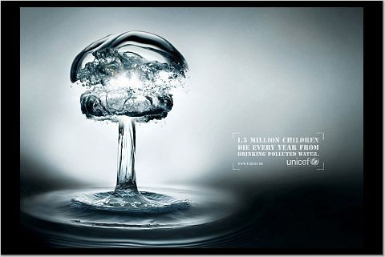

Slide 3
1 picture’s worth 1000 words

Slide 4
UNIFIED MODELING LANGUAGE

Slide 5
WHAT IS UML?
Unified Modeling Language
  OMG Standard, Object Management Group
  Based on work from Booch, Rumbaugh, Jacobson
UML is a modeling language to express and design documents, software
  Particularly useful for OO design
  Not a process, but some have been proposed using UML
  Independent of implementation language

Slide 6
WHY USE UML?
Standard language for specifying, visualizing, constructing, and documenting the artifacts of software systems, business modeling and other non-software systems.
The UML represents a collection of best engineering practices that have proven successful in the modeling of large and complex systems.
The UML is a very important part of developing object oriented software and the software development process.
The UML uses mostly graphical notations to express the design of software projects.
Using the UML helps project teams communicate, explore potential designs, and validate the architectural design of the software.

Slide 7
BRIEF HISTORY
Inundated with methodologies in early 90’s
  Booch, Jacobson, Yourden, Rumbaugh
Booch, Jacobson merged methods 1994
Rumbaugh joined 1995
1997 UML 1.1 from OMG includes input from others, e.g. Yourden
UML v2.5 current version

Slide 8
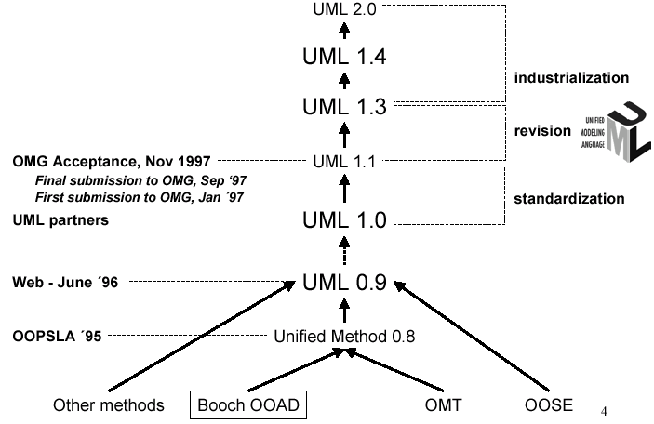
HISTORY OF UML

Slide 9
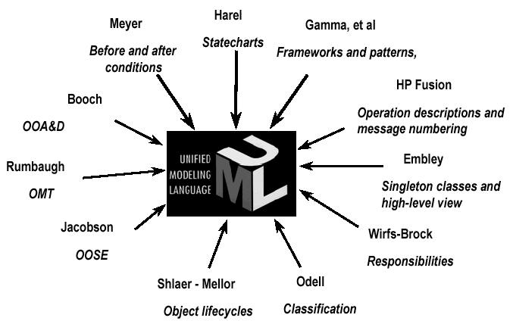
CONTRIBUTIONS TO UML

Slide 10
DIAGRAMS
Structure diagram
  Object diagram
  Class diagram
  Component diagram
  Deployment diagram
  Package diagram
  Composite structure diagram (UML 2.2)
  Profile diagram (UML 2.2)
Behavior diagram
  Interaction diagrams:
    Sequence diagram
    Collaboration diagram (communication diagram in UML 2.2)
    Interaction overview diagram (UML 2.2)
    Timing diagram (UML 2.2)
  Use case diagram
  Activity diagram
  State diagram

Slide 11
SYSTEMS, MODELS AND VIEWS
A model is an abstraction describing a subset of a system
A view depicts selected aspects of a model
A notation is a set of graphical or textual rules for depicting views
Views and models of a single system may overlap each other
Examples:
System: Aircraft
Models: Flight simulator, machine model
Views: Radar, electrical wiring, fuel system

Slide 12
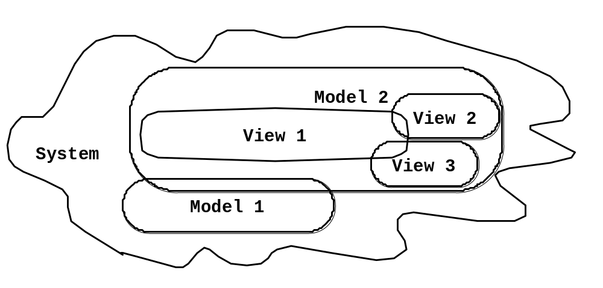
SYSTEMS, MODELS AND VIEWS
Flightsimulator
Weather
Radar
Aircraft
Electrical
Wiring
Machine Model

Slide 13
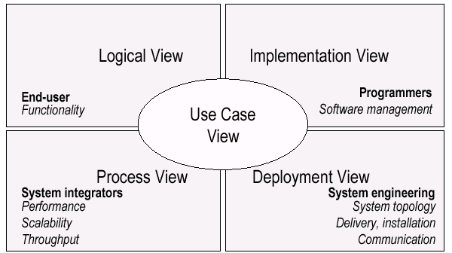
UML MODELS, VIEWS, DIAGRAMS
UML is a multi-diagrammatic language
  Each diagram is a view into a model
    Diagram presented from the aspect of a particular stakeholder
    Provides a partial representation of the system
    Is semantically consistent with other views
  Example views:

Slide 14
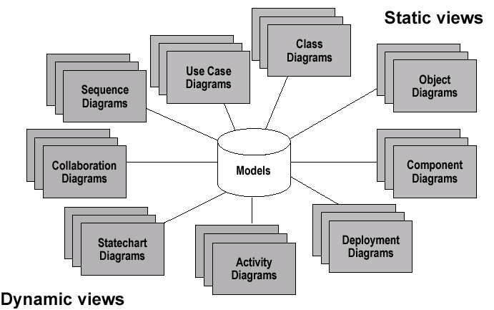
MODELS, VIEWS, DIAGRAMS

Slide 15

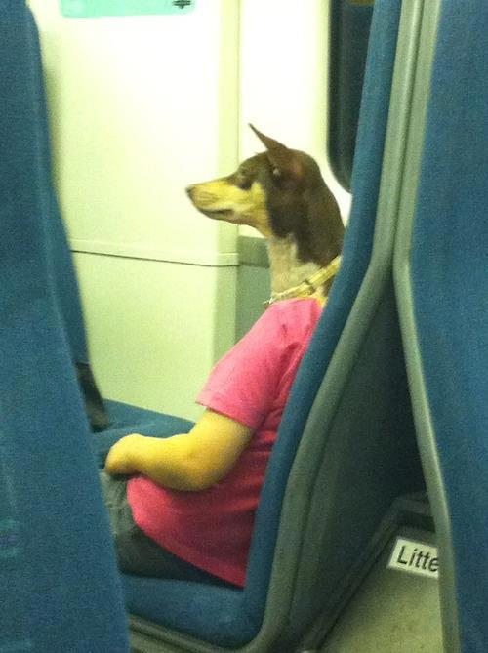


Slide 16
HOW MANY VIEWS?
Views should to fit the context
  Not all systems require all views
  Single processor: drop deployment view
  Single process: drop process view
  Very small program: drop implementation view
A system might need additional views
  Data view, security view, …

Slide 17
UML: FIRST PASS
You can model 80% of most problems by using about 20 % UML
We only cover the 20% here

Slide 18
BASIC MODELING STEPS
Use Cases
  Capture requirements
Domain Model
  Capture process, key classes
Design Model
  Capture details and behaviors of use cases and domain objects
  Add classes that do the work and define the architecture

Slide 19
UML BASELINE
Use Case Diagrams
Class Diagrams
Package Diagrams
Interaction Diagrams
  Sequence
  Collaboration
Activity Diagrams
State Transition Diagrams
Deployment Diagrams

Slide 20
USE CASE DIAGRAMS
Used during requirements elicitation to represent external behavior
Actors represent roles, that is, a type of user of the system
Use cases represent a sequence of interaction for a type of functionality; summary of scenarios
The use case model is the set of all use cases. It is a complete description of the functionality of the system and its environment
Passenger
Purchase Ticket

Slide 21
ACTORS
An actor models an external entity which communicates with the system:
  User
  External system
  Physical environment
An actor has a unique name and an optional description.
Examples:
  Passenger: A person in the train
  GPS satellite: Provides the system with GPS coordinates
Passenger

Slide 22
USE CASE
A use case represents a class of functionality provided by the system as an event flow.
A use case consists of:
Unique name
Participating actors
Entry conditions
Flow of events
Exit conditions
Special requirements
Purchase Ticket

Slide 23
USE CASE DIAGRAM: EXAMPLE
Event flow:
1. Passenger selects the number of zones to be traveled.
2. Distributor displays the amount due.
3. Passenger inserts money, of at least the amount due.
4. Distributor returns change.
5. Distributor issues ticket.
Name: Purchase ticket
Participating actor: Passenger
Entry condition:
Passenger standing in front of ticket distributor.
Passenger has sufficient money to purchase ticket.
Exit condition:
Passenger has ticket.

Slide 24
THE <<EXTENDS>> RELATIONSHIP
<<extends>> relationships represent exceptional or seldom invoked cases.
The exceptional event flows are factored out of the main event flow for clarity.
Use cases representing exceptional flows can extend more than one use case.
Passenger
PurchaseTicket
<<extends>>
<<extends>>
<<extends>>
TimeOut
OutOfOrder
<<extends>>
Cancel
NoChange

Slide 25
THE <<INCLUDES>> RELATIONSHIP
<<includes>> relationship represents behavior that is factored out of the use case.
<<includes>> behavior is factored out for reuse, not because it is an exception.
The direction of a <<includes>> relationship is to the using use case (unlike <<extends>> relationships).
Passenger
PurchaseMultiCard
PurchaseSingleTicket
<<includes>>
<<includes>>
CollectMoney
<<extends>>
<<extends>>
NoChange
Cancel

Slide 26
USE CASES ARE USEFUL TO…
Determining requirements
  New use cases often generate new requirements as the system is analyzed and the design takes shape.
Communicating with clients
  Their notational simplicity makes use case diagrams a good way for developers to communicate with clients.
Generating test cases
  The collection of scenarios for a use case may suggest a suite of test cases for those scenarios.
Explain?

Slide 27
USE CASE DIAGRAMS: SUMMARY
Use case diagrams represent external behavior
Use case diagrams are useful as an index into the use cases
Use case descriptions provide meat of model, not the use case diagrams.
All use cases need to be described for the model to be useful.
Explain?

Slide 28
CLASS DIAGRAMS
Gives an overview of a system by showing its classes and the relationships among them.
  Class diagrams are static
  they display what interacts but not what happens when they do interact
Also shows attributes and operations of each class
Good way to describe the overall architecture of system components

Slide 29
CLASS DIAGRAM PERSPECTIVES
We draw Class Diagrams under three perspectives
  Conceptual
    Software independent
    Language independent
  Specification
    Focus on the interfaces of the software
  Implementation
    Focus on the implementation of the software

Slide 30
CLASSES – NOT JUST FOR CODE
Name
TariffSchedule
TariffSchedule
Table zone2price
Enumeration getZones()
Price getPrice(Zone)
Attributes
zone2price
getZones()
getPrice()
Operations
Signature
TariffSchedule
A class represent a concept
A class encapsulates state (attributes) and behavior (operations).
Each attribute has a type.
Each operation has a signature.
The class name is the only mandatory information.

Slide 31
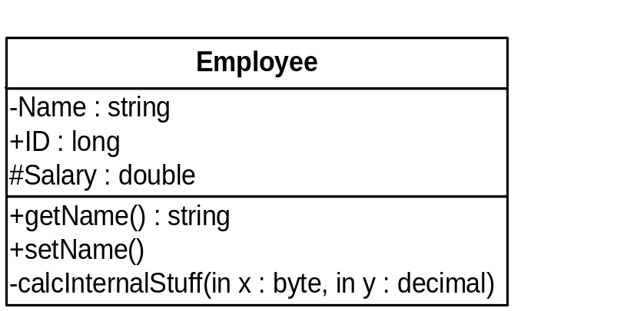
UML CLASS NOTATION
A class is a rectangle divided into three parts
  Class name
  Class attributes (i.e. data members, variables)
  Class operations (i.e. methods)
Modifiers
  Private: -
  Public: +
  Protected: #
  Static: Underlined (i.e. shared among all members of the class)
Abstract class: Name in italics

Slide 32
UML CLASS NOTATION
Lines or arrows between classes indicate relationships
  Association
    A relationship between instances of two classes, where one class must know about the other to do its work, e.g. client communicates to server
    indicated by a straight line or arrow
  Aggregation
    An association where one class belongs to a collection, e.g. instructor part of Faculty
    Indicated by an empty diamond on the side of the collection
  Composition
    Strong form of Aggregation
    Lifetime control; components cannot exist without the aggregate
    Indicated by a solid diamond on the side of the collection
  Inheritance
    An inheritance link indicating one class a superclass relationship, e.g. bird is part of mammal
    Indicated by triangle pointing to superclass

Slide 33

BINARY ASSOCIATION
Binary Association: Both entities “Know About” each other
myB.service();
myA.doSomething();
Optionally, may create an Associate Class

Slide 34

UNARY ASSOCIATION
A knows about B, but B knows nothing about A
Example?
myB.service();
Arrow points in direction
of the dependency

Slide 35

AGGREGATION
Aggregation is an association with a “collection-member” relationship
void doSomething()
aModule.service();
Hollow diamond on
the Collection side
No sole ownership implied

Slide 36
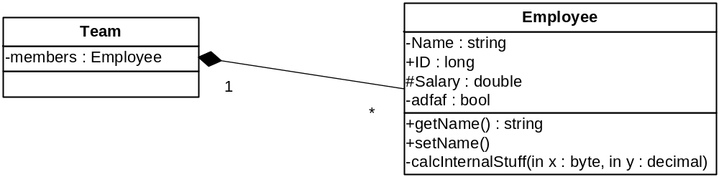
COMPOSITION
Composition is Aggregation with:
Lifetime Control (owner controls construction, destruction)
Part object may belong to only one whole object
members[0] =
new Employee();
…
delete members[0];
Filled diamond on side of the Collection

Slide 37
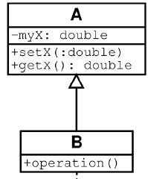
INHERITANCE
Standard concept of inheritance
Base Class
Derived Class
class B() extends A
…

Slide 38
UML MULTIPLICITIES
Multiplicities | Meaning
0..1 | zero or one instance. The notation n . . m indicates n to m instances.
0..* or * | no limit on the number of instances (including none).
1 | exactly one instance
1..* | at least one instance

Slide 39
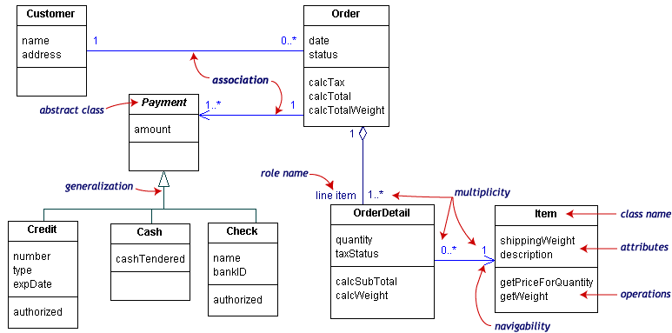
UML CLASS EXAMPLE

Slide 40
ASSOCIATION DETAILS
Can assign names to the ends of the association to give further information
Team
-
Employee
group
-
Name
:
string
-
members
:
Employee
-
individual
+
ID
:
long
1
#
Salary
:
double
*
-
adfaf
:
bool
+
getName
() :
string
+
setName
()
-
calcInternalStuff
(
in x
:
byte
,
in y
:
decimal
)

Slide 41
STATIC VS. DYNAMIC DESIGN
Static design describes code structure and object relations
  Class relations
  Objects at design time
  Doesn’t change
Dynamic design shows communication between objects
  Similarity to class relations
  Can follow sequences of events
  May change depending upon execution scenario
  Called Object Diagrams

Slide 42
OBJECT DIAGRAMS
Shows instances of Class Diagrams and links among them
  An object diagram is a snapshot of the objects in a system
    At a point in time
    With a selected focus
      Interactions – Sequence diagram
      Message passing – Collaboration diagram
      Operation – Deployment diagram

Slide 43
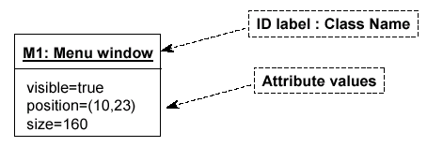
OBJECT DIAGRAMS
Format is
  Instance name : Class name
  Attributes and Values
  Example:

Slide 44
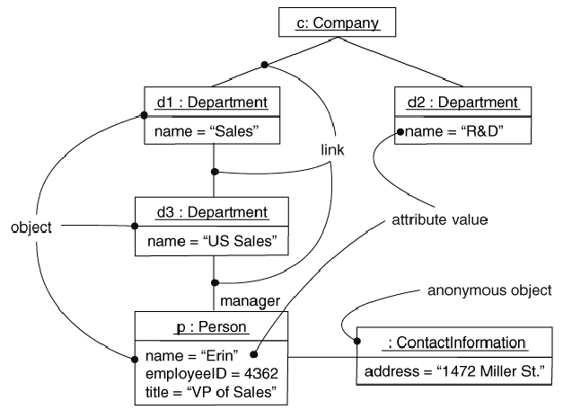
OBJECTS AND LINKS
Can add association type and also message type

Slide 45
PACKAGE DIAGRAMS
To organize complex class diagrams, you can group classes into packages. A package is a collection of logically related UML elements
Notation
  Packages appear as rectangles with small tabs at the top.
  The package name is on the tab or inside the rectangle.
  The dotted arrows are dependencies. One package depends on another if changes in the other could possibly force changes in the first.
  Packages are the basic grouping construct with which you may organize UML models to increase their readability

Slide 46
PACKAGE EXAMPLE
Dispatcher Interface
Notification
IncidentManagement

Slide 47
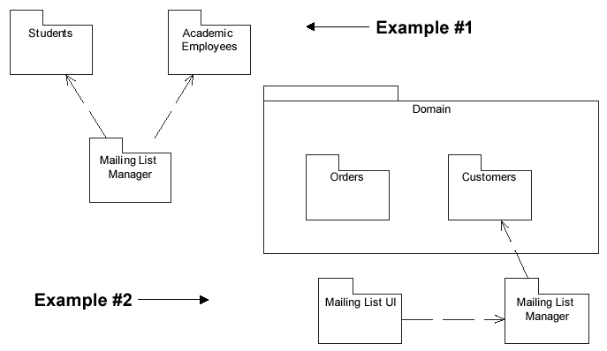
MORE PACKAGE EXAMPLES

Slide 48
INTERACTION DIAGRAMS
Interaction diagrams are dynamic -- they describe how objects collaborate.
A Sequence Diagram:
  Indicates what messages are sent and when
  Time progresses from top to bottom
  Objects involved are listed left to right
  Messages are sent left to right between objects in sequence

Slide 49
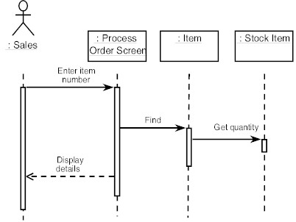
SEQUENCE DIAGRAM FORMAT
Actor from
Use Case
Objects
1
Activation
2
3
4
Lifeline
Calls = Solid Lines
Returns = Dashed Lines

Slide 50
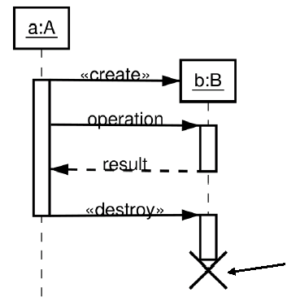
SEQUENCE DIAGRAM : DESTRUCTION
Shows Destruction of b
(and Construction)

Slide 51
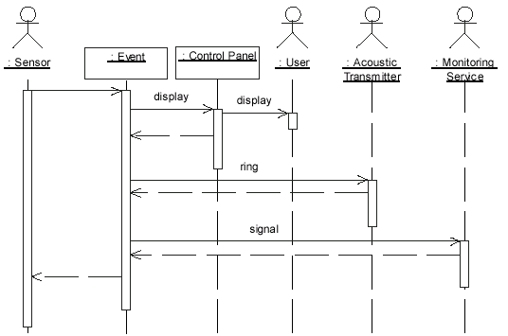
SEQUENCE EXAMPLE: ALARM SYSTEM
When the alarm goes off, it rings the alarm, puts a message on the display, notifies the monitoring service

Slide 52
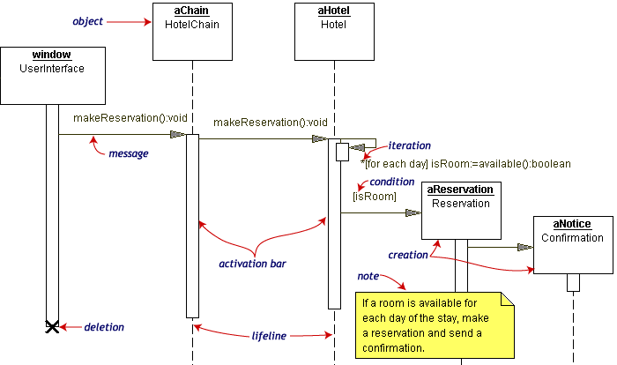
SEQUENCE DIAGRAM EXAMPLE
Hotel Reservation

Slide 53
COLLABORATION DIAGRAM
Collaboration Diagrams show similar information to sequence diagrams, except that the vertical sequence is missing. In its place are:
  Object Links - solid lines between the objects that interact
  On the links are Messages - arrows with one or more message name that show the direction and names of the messages sent between objects
Emphasis on static links as opposed to sequence in the sequence diagram

Slide 54
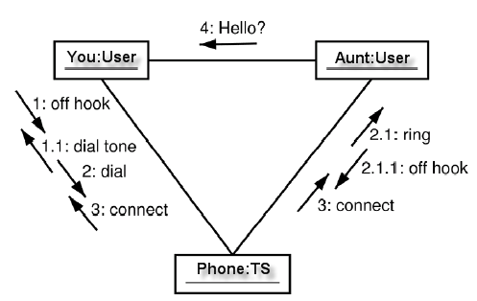
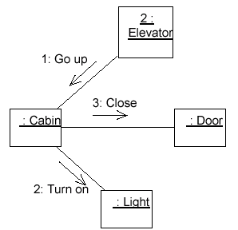
COLLABORATION DIAGRAM

Slide 55


ACTIVITY DIAGRAMS
Fancy flowchart
  Displays the flow of activities involved in a single process
  States
    Describe what is being processed
    Indicated by boxes with rounded corners
  Swim lanes
    Indicates which object is responsible for what activity
  Branch
    Transition that branch
    Indicated by a diamond
  Fork
    Transition forking into parallel activities
    Indicated by solid bars
  Start and End

Slide 56
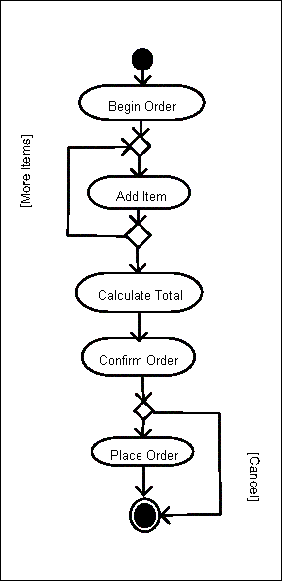
SAMPLE ACTIVITY DIAGRAM
Ordering System
May need multiple diagrams from other points of view

Slide 57

ACTIVITY DIAGRAM EXAMPLE

Slide 58
STATE TRANSITION DIAGRAMS
Fancy version of a DFA
Shows the possible states of the object and the transitions that cause a change in state
  i.e. how incoming calls change the state
Notation
  States are rounded rectangles
  Transitions are arrows from one state to another. Events or conditions that trigger transitions are written beside the arrows.
  Initial and Final States indicated by circles as in the Activity Diagram
    Final state terminates the action; may have multiple final states

Slide 59
STATE REPRESENTATION
The set of properties and values describing the object in a well defined instant are characterized by
  Name
  Activities (executed inside the state)
    Do/ activity
  Actions (executed at state entry or exit)
    Entry/ action
    Exit/ action
  Actions executed due to an event
    Event [Condition] / Action ^Send Event

Slide 60
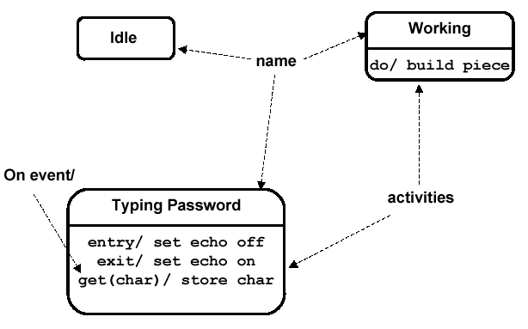
NOTATION FOR STATES

Slide 61
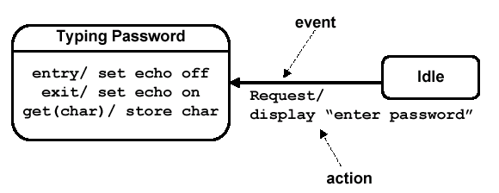
SIMPLE TRANSITION EXAMPLE

Slide 62
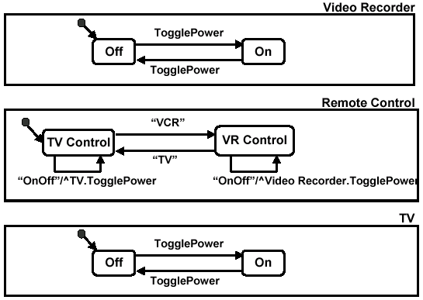
MORE SIMPLE STATE EXAMPLES

Slide 63
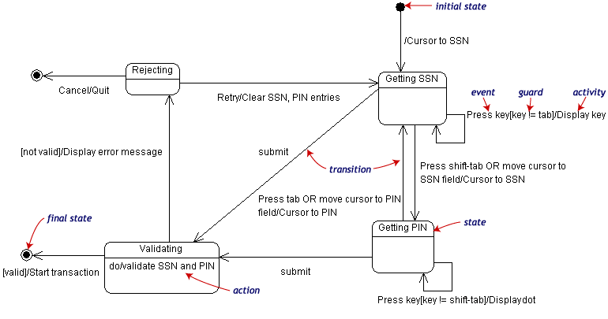
STATE TRANSITION EXAMPLE
Validating PIN/SSN

Slide 64
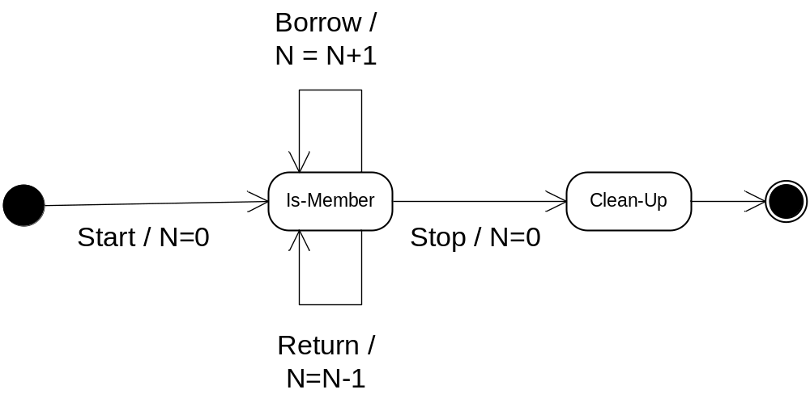
STATE CHARTS – LOCAL VARIABLES
State Diagrams can also store their own local variables, do processing on them
Library example counting books checked out and returned

Slide 65
COMPONENT DIAGRAMS
Shows various components in a system and their dependencies, interfaces
Explains the structure of a system
Usually a physical collection of classes
  Similar to a Package Diagram in that both are used to group elements into logical structures
  With Component Diagrams all of the model elements are private with a public interface whereas Package diagrams only display public items.

Slide 66


COMPONENT DIAGRAM NOTATION
Components are shown as rectangles with two tabs at the upper left
Dashed arrows indicate dependencies
Circle and solid line indicates an interface to the component

Slide 67
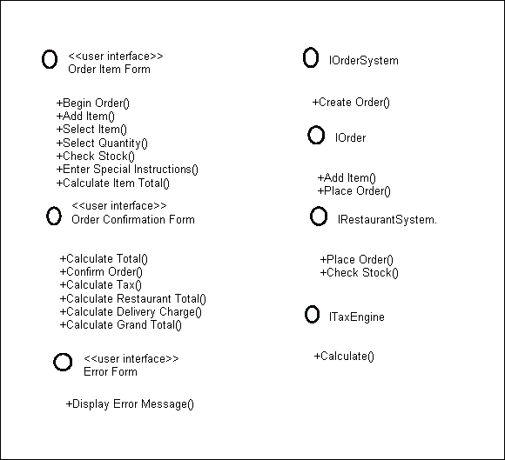
COMPONENT EXAMPLE - INTERFACES
Restaurant ordering system
Define interfaces first – comes from Class Diagrams

Slide 68
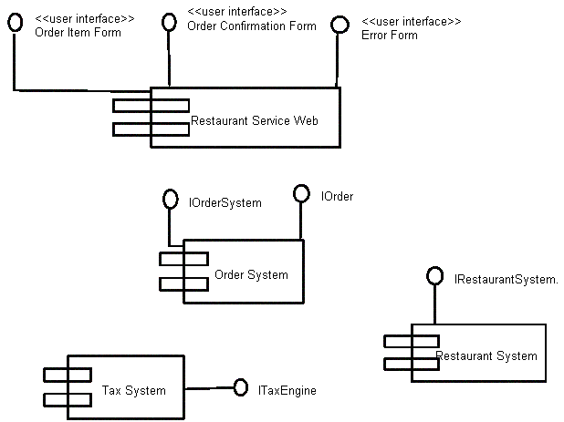
COMPONENT EXAMPLE - COMPONENTS
Graphical depiction of components

Slide 69
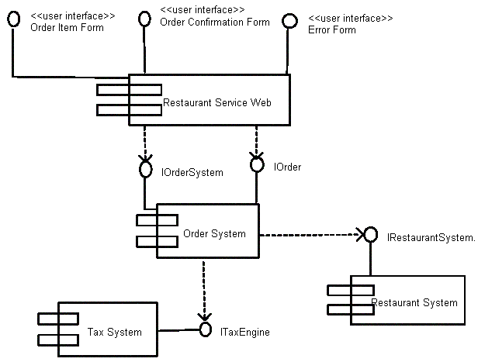
COMPONENT EXAMPLE - LINKING
Linking components with dependencies

Slide 70
DEPLOYMENT DIAGRAMS
Shows the physical architecture of the hardware and software of the deployed system
Nodes
  Typically contain components or packages
  Usually some kind of computational unit; e.g. machine or device (physical or logical)
Physical relationships among software and hardware in a delivered systems
  Explains how a system interacts with the external environment

Slide 71
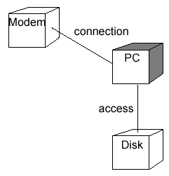
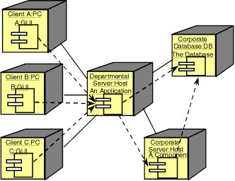
SOME DEPLOYMENT EXAMPLES

Slide 72
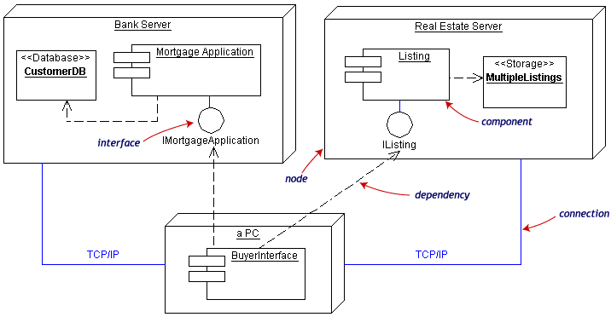
DEPLOYMENT EXAMPLE
Often the Component Diagram is combined with the Deployment

Slide 73
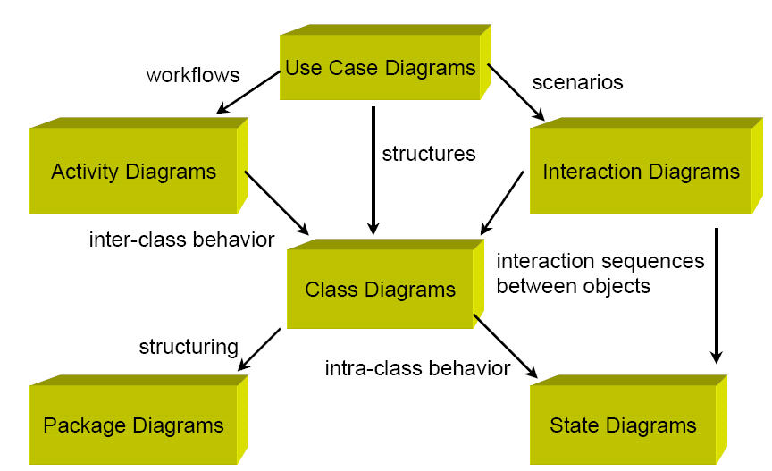
SUMARY

Slide 74
DISCUSSION

Slide 75
PROBLEM
Draw Fit portal use case diagram
Describe the function “Send message” on Fit portal by an Activity diagram
Design the function “Send message” by a Sequence diagram

Slide 76
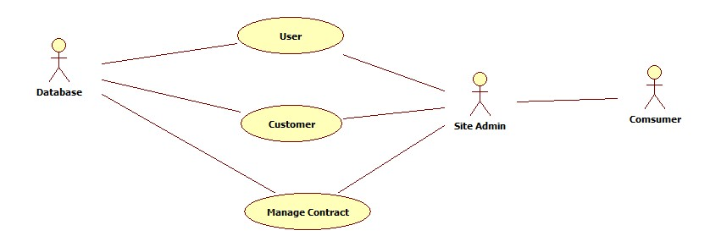
USE CASE DIAGRAM

Slide 77
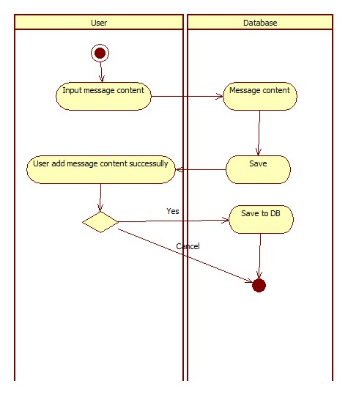
ACTIVITY DIAGRAM

Slide 78
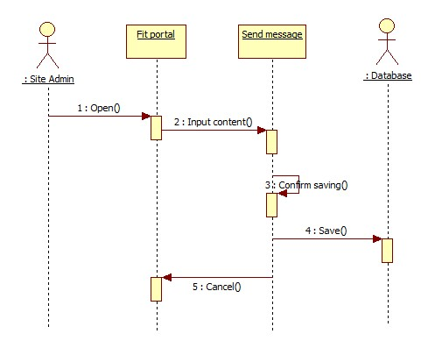
SEQUENCE DIAGRAM

Slide 79
THANKS FOR YOUR ATTENTION

